Slide 1
DAILY DATA REPORTING 15
SUMANTH S
AF0363570

Slide 2
IDENTIFYING THE ANOMALIES
Task 1 : did anyone took more time on day 15 than day 14?
Task2:did anyone take longer because they were focusing too much on the quality?
Task3:how many have shown improvement in terms of TPT on day14
Task4: who are the top 3 members with the lowest TPT on the 15th day and who are 3 members with lowest average TPT against the day 1 to day 15 ?Are they the same person?
which chart would you insight for each of the above points?
what is the average of TPT against the each day?

Slide 3
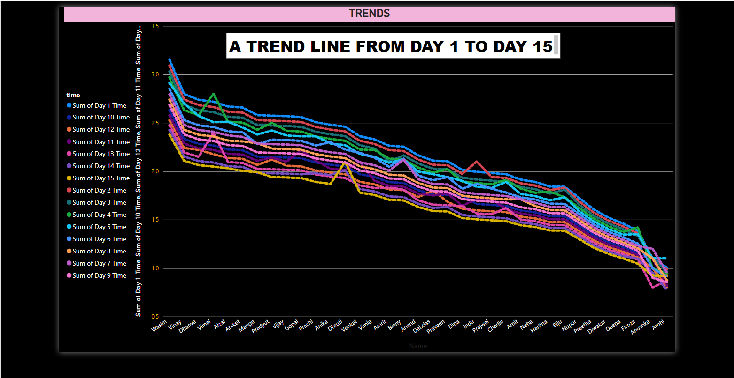

Slide 4
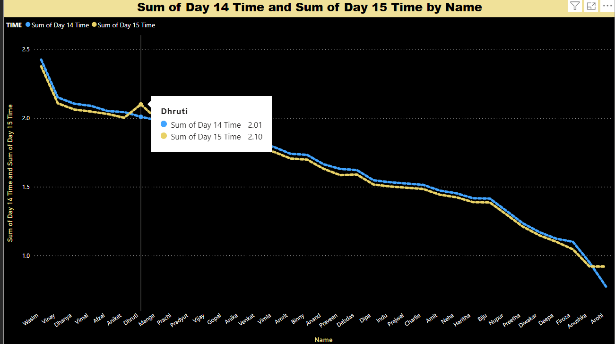
Task 1: did anyone take more time on day 15 than on day 14?

Slide 5
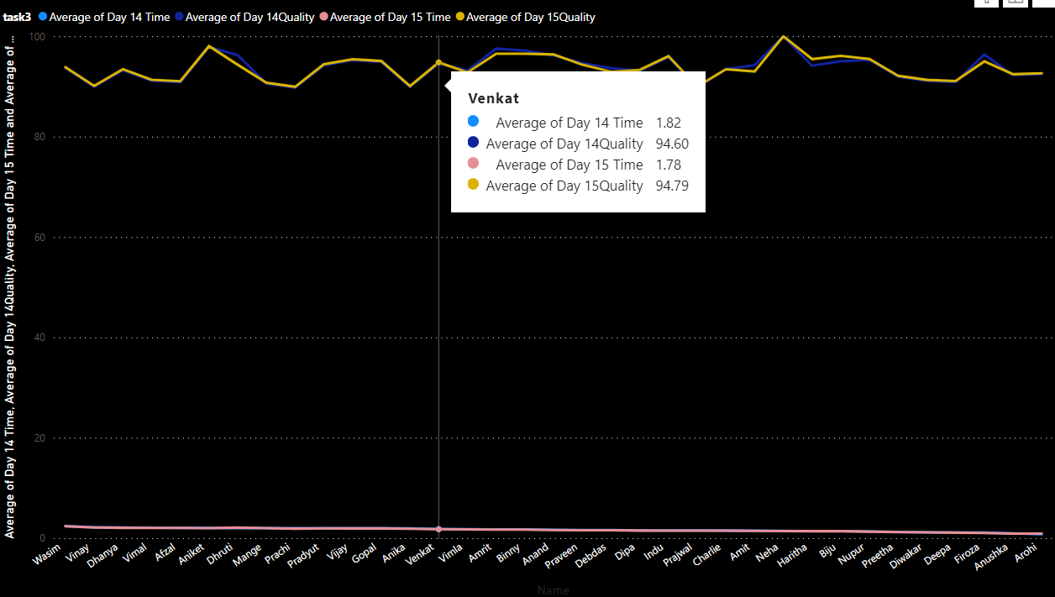
Task 2: Did anyone take longer because they were focusing too much on the quality?

Slide 6
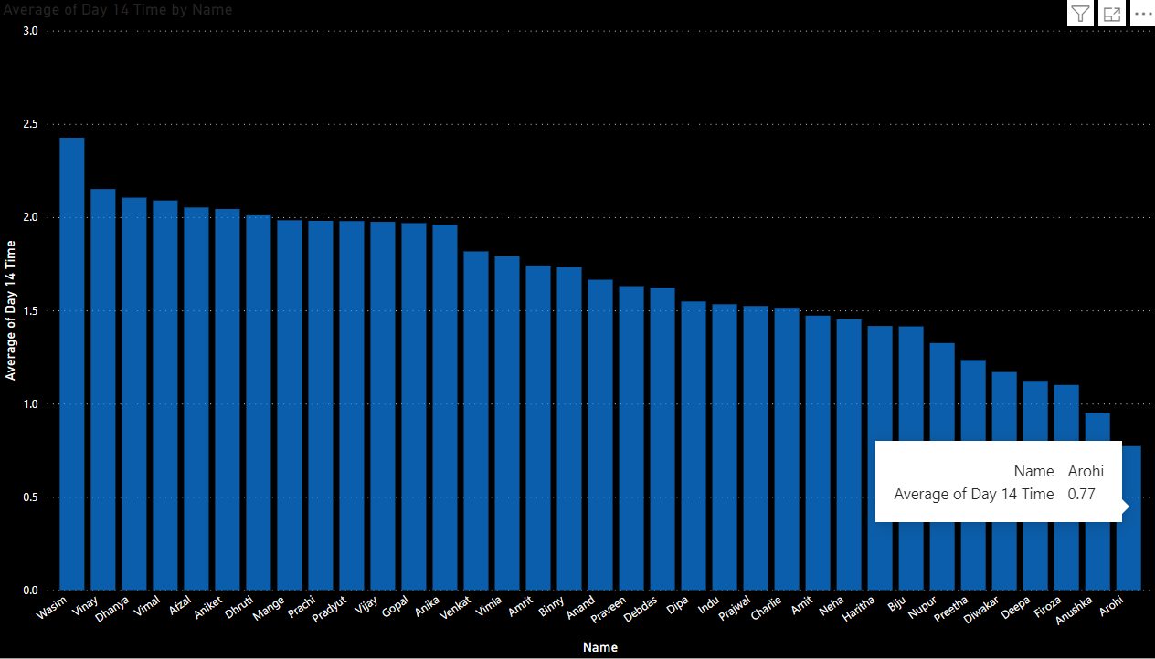
how many have shown improvement in terms of TPT on day14

Slide 7
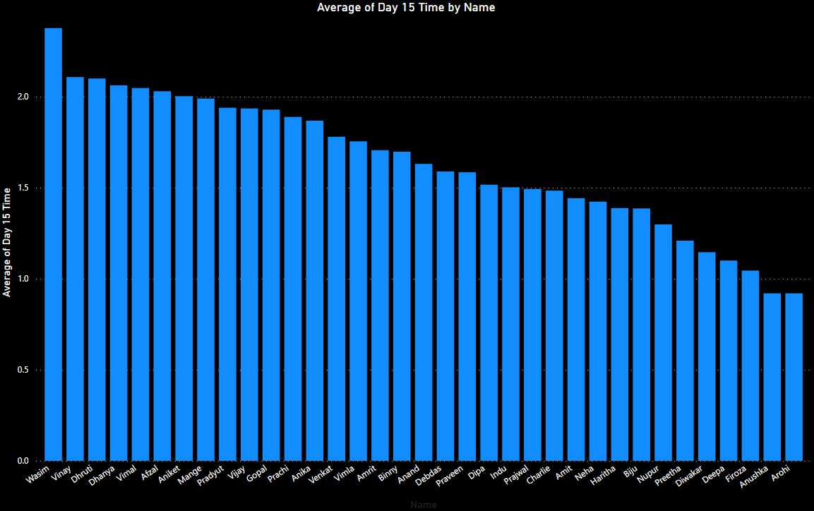
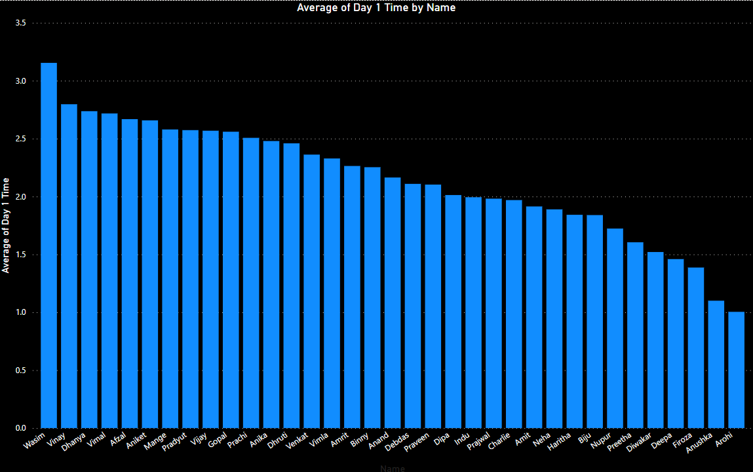
Task4: who are the top 3 members with the lowest TPT on the 15th day and who are 3 members with lowest average TPT against the day 1 to day 15 ?Are they the same person?
Yes, they are the same

Slide 8
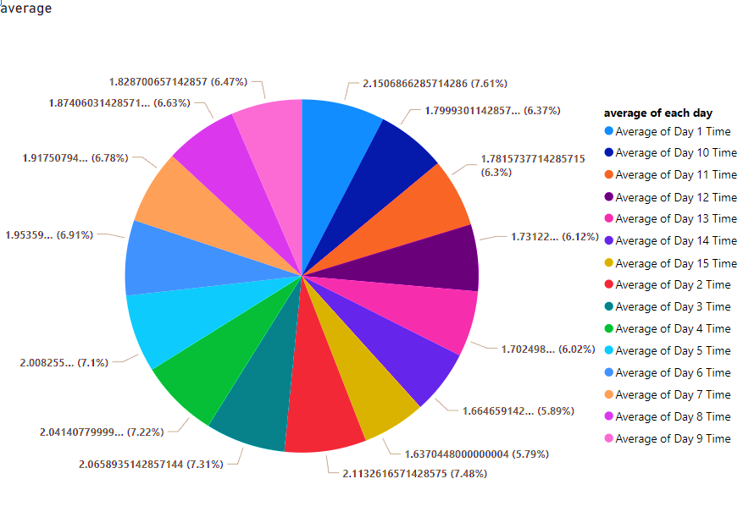
What is the average of TPT against each day?

